Slide 1
Advanced State Modeling

Slide 2
Conventional state diagrams are sufficient for describing simple systems but need additional power to handle large problems.
Complex systems can be richly modeled using:
Nested state diagrams
Nested states
Signal generalization
Concurrency

Slide 3
Nested State Diagrams:
Problems with Flat State Diagrams
State diagrams have often been criticized because they allegedly are impractical for large problems. This problem is true of flat, unstructured state diagrams.

Slide 4
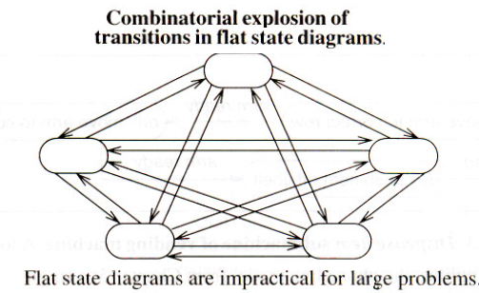
OR
Consider the state diagram below in which n² transitions are needed to connect every state to every other state.
If this model can be reformulated using structure, the number of transitions could be reduced as low as n.
Complex systems typically contain much redundancy that structuring mechanisms can simplify.

Slide 5
Expanding States
One way to organize a model is by having a high-level diagram with sub-diagrams expanding certain states.
This is like a macro substitution in a programming language.

Slide 6
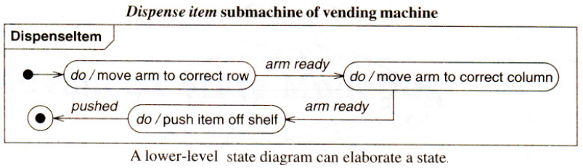

Slide 7
The UML notation for invoking a submachine is to list a local state name followed by a colon and the submachine name.
Conceptually, the submachine state diagram replaces the local state.
Effectively, a submachine is a state diagram "subroutine."

Slide 8
Nested States:
States can be structured more deeply than just replacing a state with a submachine. As a deeper alternative, states can be nested to show their commonality and share behavior.

Slide 10
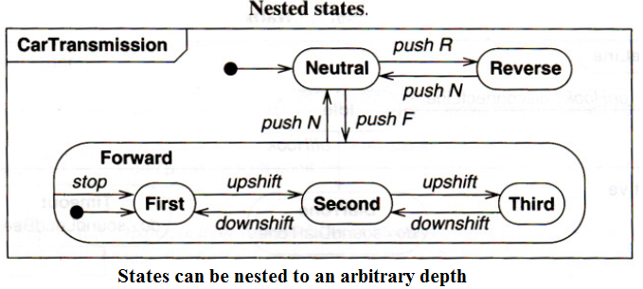
States may be nested to an arbitrary depth. A nested state receives the outgoing transitions of its composite state. (By necessity, only ingoing transitions with a specified nested state can be shared, or there would be ambiguity.)
Figure shows a state diagram for an automobile automatic transmission. The transmission can be in reverse, neutral, or forward; if it is in forward, it can be in first, second, or third gear. States First, Second, and Third are nested states of state Forward.

Slide 11
Each of the nested states receives the outgoing transitions of its composite state: Selecting "N" in any forward gear shifts a transition to neutral. The transition from Forward to Neutral implies three transitions, one from each forward gear to neutral.
Selecting "F" in neutral causes a transition to forward. Within state Forward, nested state First is the default initial state, shown by the unlabeled transition from the solid circle within the Forward contour.
Forward is just an abstract state; control must be in a real state, such as First.
All three nested states share the transition on event stop from the Forward contour to state First. In any forward gear, stopping the car causes a transition to First.

Slide 12
It is possible to represent more complicated situations, such as an explicit transition from a nested state to a state outside the contour, or an explicit transition into the contour. In such cases, all the states must appear on one diagram.
In simpler cases where there is no interaction except for initiation and termination, the nested states can be drawn as separate diagrams and they can be referenced by including a submachine, as in the previous vending machine example.

Slide 13
For simple problems, nested states can be implemented by degradation into "flat" state diagrams. Another option is to promote each state to a class, but then one must take special care to avoid loss of object identity.

Slide 14
Entry and exit activities are particularly useful in nested state diagrams because they permit a state (possibly an entire sub-diagram) to be expressed in terms of matched entry-exit activities without regard for what happens before or after the state is active. Transitioning into or out of a nested state can cause execution of several entry or exit activities, if the transition reaches across several levels of nesting. The entry activities are executed from the outside in and the exit activities from the inside out. This permits behavior similar to nested subroutine calls.

Slide 15
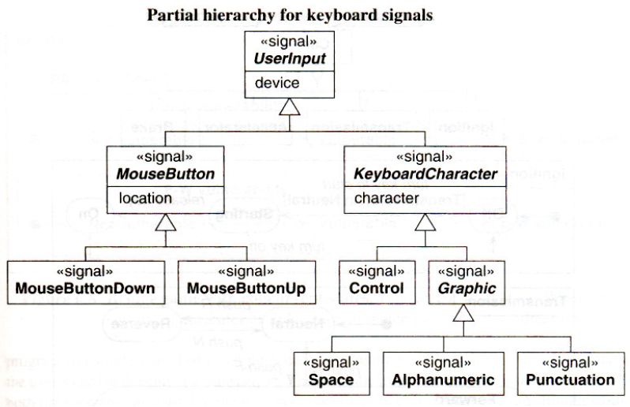
Signal Generalization
Signals can be organized into a generalization hierarchy with inheritance of signal attributes.
Figure shows part of a tree of input signals for a workstation. Signals MouseButton and KeyboardCharacter are two kinds of user input. Both signals inherit attribute device from signal User/nput (the root of the hierarchy). MouseButtonDown and MouseButtonUp inherit location from MouseButton. KeyboardCharacters can be divided into Control and Graphic characters.

Slide 16
Ultimately every actual signal can be viewed as a leaf on a generalization tree of signals.
In a state diagram, a received signal triggers transitions that are defined for any ancestor signal type.
E.g. typing an 'a' would trigger a transition on signal Alphanumeric as well as signal KeyboardCharacter. Analogous to generalization of classes, it is recommended that all super-signals be abstract.

Slide 17
A signal hierarchy permits different levels of abstraction to be used in a model.
E.g.
some states might handle all input characters the same;
other states might treat control characters differently from printing characters;
still others might have different activities on individual characters.

Slide 18
Concurrency
The state model implicitly supports concurrency among objects.
In general, objects are autonomous entities that can act and change state independent of one another.
However, objects need not be completely independent and may be subject to shared constraints that cause some correspondence among their state changes.

Slide 19
Aggregation Concurrency:
A state diagram for an assembly is a collection of state diagrams, one for each part. The aggregate state corresponds to the combined states of all the parts. Aggregation is the "and-relationship."
The aggregate state is one state from the first diagram, and a state from the second diagram, and a state from each other diagram.
In the more interesting cases, the part states interact. Transitions for one object can depend on another object being in a given state. This allows interaction between the state diagrams, while preserving modularity

Slide 20
Figure shows the state of a Car as an aggregation of part states: Ignition, Transmission, Accelerator, and Brake (plus other unmentioned objects).
The state of the car includes one state from each part. Each part undergoes transitions in parallel with all the others. The state diagrams of the parts are almost, but not quite, independent - the car will not start unless the transmission is in neutral. This is shown by the guard expression Transmission in Neutral on the transition from Ignition-Off to Ignition-Starting.

Slide 21
Concurrency within an Object
Some objects can be partitioned into subsets of attributes or links, each of which has its own sub-diagram. The state of the object comprises one state from each sub-diagram. The sub-diagrams need not be independent; the same event can cause transitions in more than one sub-diagram.
The UML shows concurrency within an object by partitioning the composite state into regions with dotted lines. Name of the composite state must be placed in a separate tab so that it does not become confused with the concurrent regions.

Slide 22
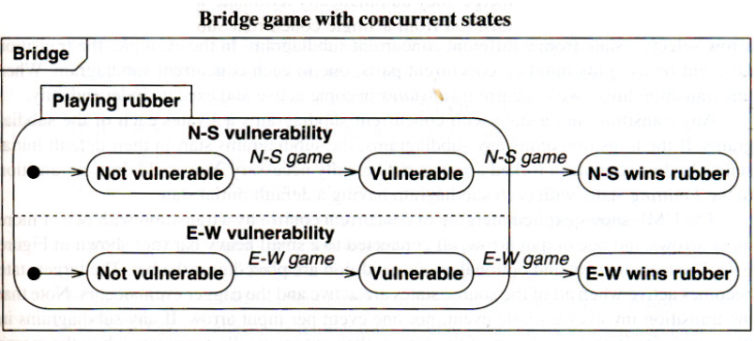
Figure shows the state diagram for the play of a bridge rubber. When a side wins a game, it becomes "vulnerable"; the first side to win two games wins the rubber. During the play of the rubber, the state of the rubber consists of one state from each sub-diagram.
When the Playing rubber composite state is entered, both regions are initially in their respective default states Not vulnerable. Each region can independently advance to state Vulnerable when its side wins a game. When one side wins a second game, a transition occurs to the corresponding Wins rubber state. This transition terminates both concurrent regions, because they are part of the same composite state Playing rubber and are active only when the top level state diagram is in that state.

Slide 23
Most programming languages lack intrinsic support for concurrency. A library, operating system primitives, or a DBMS can be used to provide concurrency. During analysis all objects should be regarded as concurrent. During design best accommodation is devised; many implementations do not require concurrency, and a single thread of control suffices.

Slide 24
Synchronization of Concurrent Activities
Sometimes one object must perform two (or more) activities concurrently. The object does not synchronize the internal steps of the activities but must complete both activities before it can progress to its next state. E.g. a cash dispensing machine dispenses cash and returns the user's card at the end of a transaction. The machine must not reset itself until the user takes both the cash and the card, but the user may take them in either order or even simultaneously.
The order in which they are taken is irrelevant, only the fact that both of them have been taken. This is an example of splitting control into concurrent activities and later merging control.

Slide 25
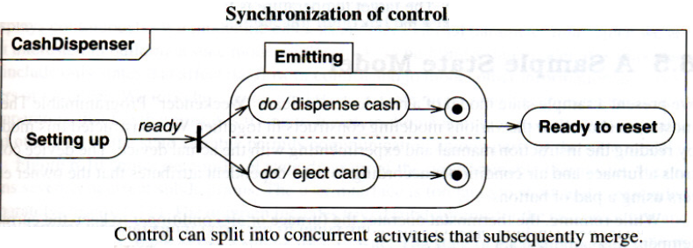
Figure shows a concurrent state diagram for the emitting activity.

Slide 26
The number of concurrently active states varies during execution from one to two and back to one again.
The UML shows concurrent activities within a single composite activity by partitioning a state into regions with dotted lines, as explained previously. Each region is a sub-diagram that represents a concurrent activity within the composite activity. The composite activity consists of exactly one state from each sub-diagram.

Slide 27
A transition that forks indicates splitting of control into concurrent parts. A small heavy bar with one input arrow and two or more output arrows denotes the fork. The event and an optional guard condition label the input arrow. The output arrows have no labels. Each output arrow selects a state from a different concurrent sub-diagram. In the example, the transition on event ready splits into two concurrent parts, one to each concurrent sub-diagram. When this transition fires, two concurrent sub-states become active and execute independently.

Slide 28
Any transition into a state with concurrent sub-diagrams activates each of the sub-diagrams. If the transition omits any sub-diagrams, the sub-diagrams start in their default initial states.
In this example, a forked arrow is not actually necessary. A transition to the Emitting state can be drawn, with each sub-diagram having a default initial state.

Slide 29
The UML shows explicit merging of concurrent control by a transition with two or more input arrows and one output arrow, all connected to a small heavy bar (not shown in Figure). The trigger event and optional guard condition are placed near the bar. The target state becomes active when all of the source states are active and the trigger event occurs. Note that the transition involves a single event, not one event per input arrow. If any sub-diagrams in the composite state are not part of the merge, they automatically terminate when the merge transition fires. As a consequence, a transition from a single concurrent sub-state to a state outside the composite state causes the other concurrent sub-states to terminate. This can be regarded as a degenerate merge involving a single state.

Slide 30
An unlabeled (completion) transition from the outer composite state to another state indicates implicit merging of concurrent control (above figure). A completion transition fires when activity in the source state is complete.
A composite concurrent state is complete when each of its concurrent sub-states is complete-that is, when each of them has reached its final state, All sub-states must complete before the completion transition fires and the composite state terminates. In the example, when both activities have been performed, both sub-states are in their final states, the merge transition fires, and state Ready to reset becomes active.

Slide 31
Drawing a separate transition from each sub-state to the target state would have a different meaning; either transition would terminate the other sub-diagram without waiting for the other. The firing of a merge transition causes a state diagram to perform the exit activities (if any) of all sub-diagrams, in the case of both explicit and implicit merges.
State diagrams are checked for consistency on shared events so that the full state model will be correct.

Slide 32
Interaction Modeling
The interaction model is the third leg of the modeling tripod and describes interactions within a system. The class model describes the objects in a system and their relationships, the state model describes the life cycles of the objects, and the interaction model describes how the objects interact.

Slide 33
The interaction model describes how objects interact to produce useful results. It is a holistic view of behavior across many objects, whereas the state model is a reductionist view of behavior that examines each object individually. Both the state model and the interaction model are needed to describe behavior fully. They complement each other by viewing behavior from two different perspectives.

Slide 34
Interactions can be modeled at different levels of abstraction.
At a high level, use cases describe how a system interacts with outside actors. Each use case represents a piece of functionality that a system provides to its users. Use cases are helpful for capturing informal requirements.
Sequence diagrams provide more detail and show the messages exchanged among a set of objects over time. Messages include both asynchronous signals and procedure calls. Sequence diagrams are good for showing the behavior sequences seen by users of a system.
And finally, activity diagrams provide further detail and show the flow of control among the steps of a computation. Activity diagrams can show data flows as well as control flows. Activity diagrams document the steps necessary to implement an operation or a business process referenced in a sequence diagram.

Slide 35
Use Case Models:
Actors:
An actor is a direct external user of a system - an object or set of objects that communicates directly with the system but that is not part of the system. Each actor represents those objects that behave in a particular way toward the system.
E.g.
customer and repair technician are different actors of a vending machine.
For a travel agency system, actors might include traveler, agent, and airline.
For a computer database system, actors might include user and administrator.
Actors can be persons, devices, and other systems-anything that interacts directly with the system.
An object can be bound to multiple actors if it has different facets to its behavior. E.g. the objects Mary, Frank, and Paul may be customers of a vending machine. Paul may also be a repair technician for the vending machine.

Slide 36
An actor has a single well-defined purpose. In contrast, objects and classes often combine many different purposes. An actor represents a particular facet of objects in its interaction with a system. The same actor can represent objects of different classes that interact similarly toward a system. E.g. Even though many different individual persons use a vending machine, their behavior toward the vending machine can all be summarized by the actors customer and repair technician.
Each actor represents a coherent set of capabilities for its objects.

Slide 37
Use Cases:
The various interactions of actors with a system are quantized into use cases. A use case is a coherent piece of functionality that a system can provide by interacting with actors.
E.g.
A customer actor can buy a beverage from a vending machine. The customer inserts money into the machine, makes a selection, and ultimately receives a beverage.
A repair technician can perform scheduled maintenance on a vending machine.

Slide 38
Figure below summarizes several use cases for a vending machine.
Buy a beverage. The vending machine delivers a beverage after a customer selects and pays for it.
Perform scheduled maintenance. A repair technician performs the periodic service on the vending machine necessary to keep it in good working condition.
Make repairs. A repair technician performs the unexpected service on the vending machine necessary to repair a problem in its operation.
Load items. A stock clerk adds items into the vending machine to replenish its stock of beverages.

Slide 39
Each use case involves one or more actors as well as the system itself. The use case buy a beverage involves the customer actor and the use case perform scheduled maintenance involves the repair technician actor. In a telephone system, the use case make a call involves two actors, a caller and a receiver.
The actors need not all be persons. The use case make a trade on an online stock broker involves a customer actor and a stock exchange actor. The stock broker system needs to communicate with both actors to execute a trade.

Slide 40
A use case involves a sequence of messages among the system and its actors. E.g. in the buy a beverage use case, the customer first inserts a coin and the vending machine displays the amount deposited. This can be repeated several times. Then the customer pushes a button to indicate a selection; the vending machine dispenses the beverage and issues change, if necessary.

Slide 41
Error conditions are also part of a use case: E.g. if the customer selects a beverage whose supply is exhausted, the vending machine displays a warning message. Similarly, the vending transaction can be cancelled. E.g. the customer can push the coin return on the vending machine at any time before a selection has been accepted; the machine returns the coins, and the behavior sequence for the use case is complete. From the user's point of view, some kinds of behavior may be thought of as errors. The designer, however, should plan for all possible behavior sequences. From the system's point of view, user errors or resource failures are just additional kinds of behavior that a robust system can accommodate.

Slide 42
A use case brings together all of the behavior relevant to a slice of system functionality. This includes normal mainline behavior, variations on normal behavior, exception conditions, error conditions, and cancellations of a request. Grouping normal and abnormal behavior (means all) under a single use case helps to ensure that all the consequences of an interaction are considered together.

Slide 43
Figure below explains the buy a beverage use case in detail.
Use Case: Buy a beverage
Summary: The vending machine delivers a beverage after a customer selects and pays for it.
Actors: Customer
Preconditions: The machine is waiting for money to be inserted.
Description: The machine starts in the waiting state in which it displays the message "Enter coins." A customer inserts coins into the machine. The machine displays the total value of money entered and lights up the buttons for the items that can be purchased for the money inserted. The customer pushes a button. The machine dispenses the corresponding item and makes change, if the cost of the item is less than the money inserted.
Exceptions:
Canceled: If the customer presses the cancel button before an item has been selected, the customer's money is returned and the machine resets to the waiting state.
Out of stock: If the customer presses a button for an out-of-stock item, the message "That item is out of stock" is displayed. The machine continues to accept coins or a selection.
Insufficient money: If the customer presses a button for an item that costs more than the money inserted, the message "You must insert $nn.nn more for that item" is displayed, where nn.nn is the amount of additional money needed. The machine continues to accept coins or a selection.
No change: If the customer has inserted enough money to buy the item but the machine cannot make the correct change, the message "Cannot make correct change" is displayed and the machine continues to accept coins or a selection.
Post-conditions: The machine is waiting for money to be inserted.

Slide 44
In a complete model, the use cases partition the functionality of the system. They should preferably all be at a comparable level of abstraction.
E.g.
The use cases make telephone call and record voice mail message are at comparable levels.
The use case set external speaker volume to high is too narrow. It would be better as set speaker volume (with the volume level selection as part of the use case) or maybe even just set telephone parameters, under which setting volume, display pad settings, setting the clock, and so on can be grouped.

Slide 45
Use Case Diagrams:
A system involves a set of use cases and a set of actors. Each use case represents a slice of the functionality the system provides. The set of use cases shows the complete functionality of the system at some level of detail. Similarly, each actor represents one kind of object for which the system can perform behavior. The set of actors represents the complete set of objects that the system can serve.

Slide 46
UML notation for summarizing use cases:
A rectangle contains the use cases for a system with the actors listed on the outside. The name of the system may be written near a side of the rectangle. A name within an ellipse denotes a use case. A "stick man" icon denotes an actor, with the name being placed below or adjacent to the icon. Solid lines connect use cases to participating actors.

Slide 47
In the figure, the actor Repair technician participates in two use cases, the others in one each. Multiple actors can participate in a use case, even though the example has only one actor per use case.

Slide 48
Guidelines for Use Case Models
First determine the system boundary: It is impossible to identify use cases or actors if the system boundary is unclear.
Ensure that actors are focused: Each actor should have a single, coherent purpose. If a real-world object embodies multiple purposes, capture them with separate actors. E.g. the owner of a personal computer may install software, set up a database, and send email. These functions differ greatly in their impact on the computer system and the potential for system damage. They might be broken into three actors: system administrator, database administrator, and computer user.

Slide 49
Relate use cases and actors: Every use case should have at least one actor, and every actor should participate in at least one use case. A use case may involve several actors, and an actor may participate in several use cases.
Remember that use cases are informal. They are not intended as a formal mechanism but as a way to identify and organize system functionality from a user-centered point of view. It is acceptable if use cases are a bit loose at first. Detail can come later as use cases are expanded and mapped into implementations.
Use cases can be structured: For many applications, the individual use cases are completely distinct. For large systems, use cases can be built out of smaller fragments using relationships (Chapter 8- use case relationships).

Slide 50
Sequence Models:
The sequence model elaborates the themes of use cases.
There are two kinds of sequence models:
Scenarios
Sequence diagrams: It is a more structured format.

Slide 51
Scenarios:
A scenario is a sequence of events that occurs during one particular execution of a system, such as for a use case. The scope of a scenario can vary; it may include all events in the system, or it may include only those events generated by certain objects.
A scenario can be displayed as a list of text statements.

Slide 52
E.g. Scenario for a session with an online stock broker.
John Doe logs in. System establishes secure communications. System displays portfolio information. John Doe enters a buy order for 100 shares of GE at the market price. System verifies sufficient funds for purchase. System displays confirmation screen with estimated cost. John Doe confirms purchase. System places order on securities exchange. System displays transaction tracking number. John Doe logs out. System establishes insecure communication. System displays good-bye screen. Securities exchange reports results of trade.

Slide 53
The example expresses interaction at a high level. E.g the step John Doe logs in might require several messages between John Doe and the system. The essential purpose of the step, however, is the request to enter the system and providing the necessary identification - the details can be shown separately. At early stages of development, scenarios should be expressed at a high level. At later stages, the exact messages can be shown. Determining the detailed messages is part of development.

Slide 54
A scenario contains messages between objects as well as activities performed by objects. Each message transmits information from one object to another. E.g. John Doe logs in transmits a message from John Doe to the broker system.
The first step of writing a scenario is to identify the objects exchanging messages. Then the sender and receiver of each message, as well as the sequence of the messages is determined.

Slide 55
Sequence Diagrams:
A text format is convenient for writing, but it does not clearly show the sender and receiver of each message, especially if there are more than two objects. A sequence diagram shows the participants in an interaction and the sequence of messages among them. A sequence diagram shows the interaction of a system with its actors to perform all or part of a use case.

Slide 56
Figure aside shows a sequence diagram corresponding to the previous stock broker scenario.
Each actor as well as the system is represented by a vertical line called a lifeline and each message by a horizontal arrow from the sender to the receiver. Time proceeds from top to bottom, but the spacing is irrelevant; the diagram shows only the sequence of messages, not their exact timing. Note that sequence diagrams can show concurrent signals stockbroker system sends messages to customer and securities exchange concurrently-and signals between participants need not alternate - stock broker system sends secure communication followed by display portfolio.

Slide 57
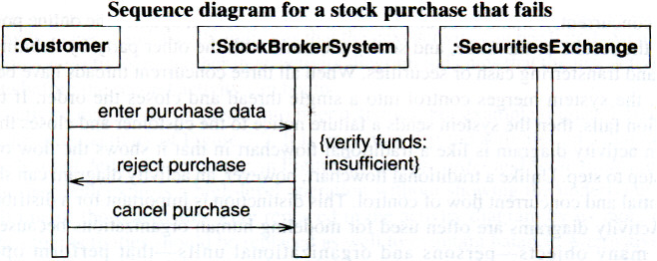
A sequence diagram must be prepared for each exception condition within the use case.
E.g. Figure below shows a variation in which the customer does not have sufficient funds to place the order. In this example, the customer cancels the order.

Slide 58
In most systems, there are an unlimited number of scenarios, so it is not possible to show them all. However, all the use cases must be elaborated to possible extent in such a way that the basic kinds of behavior must be covered with sequence diagrams.

Slide 59
Guidelines for Sequence Models
Prepare at least one scenario per use case
Abstract the scenarios into sequence diagrams
Divide complex interactions
Prepare a sequence diagram for each error condition

Slide 60
Activity Models:
An activity diagram shows the sequence of steps that make up a complex process, such as an algorithm or workflow. An activity diagram shows flow of control, similar to a sequence diagram, but focuses on operations rather than on objects. Activity diagrams are most useful during the early stages of designing algorithms and workflows.

Slide 61
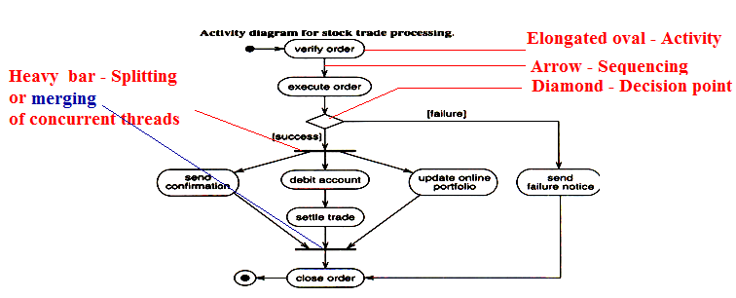
Activity diagram for the processing of a stock trade order that has been received by an online stock broker.

Slide 62
ACTIVITY DIAGRAM Vs TRADITIONAL FLOWCHART - COMPARISON
An activity diagram is like a traditional flowchart in that it shows the flow of control from step to step. Unlike a traditional flowchart, however, an activity diagram can show both sequential and concurrent flow of control. This distinction is important for a distributed system.
Activity diagrams are often used for modeling human organizations because they involve many objects-persons and organizational units - that perform operations concurrently.

Slide 63
Activities
The steps of an activity diagram are operations, specifically activities from the state model. The purpose of an activity diagram is to show the steps within a complex process and the sequencing constraints among them.
Some activities run forever until an outside event interrupts them, but most activities eventually complete their work and terminate by themselves. The completion of an activity is a completion event and usually indicates that the next activity can be started. An unlabeled arrow from one activity to another in an activity diagram indicates that the first activity must complete before the second activity can begin.

Slide 64
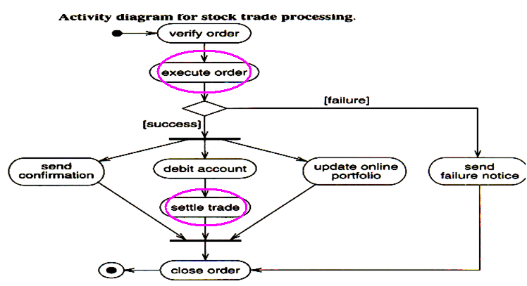
It is important that the activities on a diagram be at the same level of detail.

Slide 65
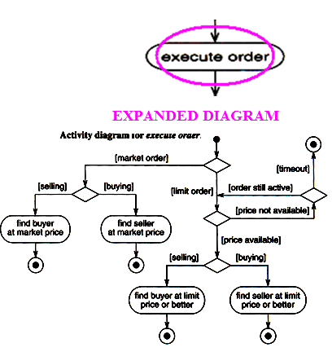
An activity may be decomposed into finer activities.

Slide 66
Balance in the level of activities on a diagram can be preserved by elaborating the activities in separate diagrams.

Slide 67
Branches
If there is more than one successor to an activity, each arrow may be labeled with a condition in square brackets, for example, [failure]. All subsequent conditions are tested when an activity completes. If one condition is satisfied, its arrow indicates the next activity to perform.
If no condition is satisfied, the diagram is badly formed and the system will hang unless it is interrupted at some higher level. To avoid this danger, the else condition can be used; it is satisfied in case no other condition is satisfied. If multiple conditions are satisfied, only one successor activity executes, but there is no guarantee which one it will be. Sometimes this kind of non-determinism is desirable, but often it indicates an error, so the modeler should determine whether any overlap of conditions can occur and whether it is correct.

Slide 68
As a notational convenience, a diamond shows a branch into multiple successors, but it means the same thing as arrows leaving an activity symbol directly. In the above figure, diamond has one incoming arrow and two outgoing arrows, each with a condition. A particular execution chooses only one path of control.
If several arrows enter an activity, the alternate execution paths merge. Alternatively, several arrows may enter a diamond and one may exit to indicate a merge.

Slide 69
Initiation and Termination
A solid circle with an outgoing arrow shows the starting point of an activity diagram. When an activity diagram is activated, control starts at the solid circle and proceeds via the outgoing arrow toward the first activities. A bull's-eye (a solid circle surrounded by a hollow circle) shows the termination point - this symbol only has incoming arrows. When control reaches a bull's-eye, the overall activity is complete and execution of the activity diagram ends.

Slide 70
Concurrent Activities
Unlike traditional flow charts, organizations and computer systems can perform more than one activity at a time. The pace of activity can also change over time. E.g. one activity may be followed by another activity (sequential control), then split into several concurrent activities (a fork of control), and finally be combined into a single activity (a merge of control). A fork or merge is shown by a synchronization bar - a heavy line with one or more input arrows and one or more output arrows. On synchronization, control must be present on all of the incoming activities, and control passes to all of the outgoing activities.

Slide 71
Executable Activity Diagrams
Activity diagrams are not only useful for defining the steps in a complex process, but they can also be used to show the progression of control during execution. An activity token can be placed on an activity symbol to indicate that it is executing. When an activity completes, the token is removed and placed on the outgoing arrow. In the simplest case, the token then moves to the next activity.

Slide 72
If there are multiple outgoing arrows with conditions, the conditions are examined to determine the successor activity. Only one successor activity can receive the token, even if more than one condition is true. If no condition is satisfied, the activity diagram is ill formed.
Multiple tokens can arise through concurrency. If an executing activity is followed by a concurrent split of control, completion causes an increase in the number of tokens-a token is placed on each of the concurrent activities. Similarly, a merge of control causes a decrease in the number of tokens as tokens migrate from the input activities to the output activities. All the input activities must complete before the merge can actually occur.

Slide 73
Guidelines for Activity Models
Don't misuse activity diagrams – Don’t use as an excuse to develop software via flowcharts.
Level diagrams – otherwise elaborate.
Be careful with branches and conditions – else and un-deterministic
Be careful with concurrent activities: before merge all inputs must complete.
Consider executable activity diagrams – helps end users.

Slide 74
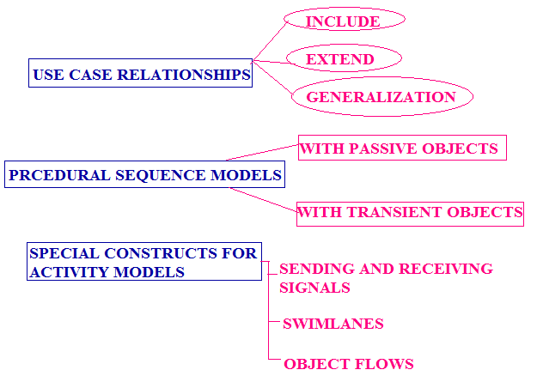
Advanced Interaction Modeling

Slide 75
Use Case Relationships:
Independent use cases suffice for simple applications. However, it can be helpful to structure use cases for large applications. Complex use cases can be built from smaller pieces with the include, extend, and generalization relationships.

Slide 76
Include Relationship
The include relationship incorporates one use case within the behavior sequence of another use case. An included use case is like a subroutine - it represents behavior that would otherwise have to be described repeatedly. Often the fragment is a meaningful unit of behavior for the actors, although this is not required. The included use case may or may not be usable on its own.
The UML notation for an include relationship is a dashed arrow from the source (including) use case to the target (included) use case. The keyword «include» annotates the arrow.

Slide 77
Figure shows an example from an online stock brokerage system.

Slide 78
A use case can also be inserted within a textual description with the notation include use-case-name. An included use case is inserted at a specific location within the behavior sequence of the larger use case, just as a subroutine is called from a specific location within another subroutine.
include relationships should not be used to structure fine details of behavior. The purpose of use case modeling is to identify the functionality of the system and the general flow of control among actors and the system. Factoring a use case into pieces is appropriate when the pieces represent significant behavior units.

Slide 79
Extend Relationship
The extend relationship adds incremental behavior to a use case. It is like an include relationship looked at from the opposite direction, in which the extension adds itself to the base, rather than the base explicitly incorporating the extension. It represents the frequent situation in which some initial capability is defined, and later features are added modularly.
The include and extend relationships both add behavior to a base use case.

Slide 80
The UML notation for an extend relationship is a dashed arrow from the extension use case to the base use case. The keyword «extend» annotates the arrow.
The base use case permits simple purchases and sales of a stock at the market price. The brokerage system adds three capabilities: buying a stock on margin, selling a stock short, and placing a limit on the transaction price. The use case trade options also has an extension for placing a limit on the transaction price.

Slide 81
The extend relationship connects an extension use case to a base use case. The extension use case often is a fragment - that is, it cannot appear alone as a behavior sequence. The base use case, however, must be a valid use case in the absence of any extensions. The extend relationship can specify an insert location within the behavior sequence of the base use case; the location can be a single step in the base sequence or a range of steps. The behavior sequence of the extension use case occurs at the given point in the sequence. In most cases, an extend relationship has a condition attached. The extension behavior occurs only if the condition is true when control reaches the insert location.

Slide 82
Generalization
Generalization can show specific variations on a general use case, analogous to generalization among classes. A parent use case represents a general behavior sequence. Child use cases specialize the parent by inserting additional steps or by refining steps.
The UML indicates generalization by an arrow with its tail on the child use case and a triangular arrowhead on the parent use case, the same notation that is used for classes.

Slide 83
E.g. an online stock brokerage system might specialize the general usecase make trade into the child use cases trade bonds, trade stocks, and trade options. The parent use case contains steps that are performed for any kind of trade, such as entering the trading password. Each child use case contains the additional steps particular to a specific kind of trade.

Slide 84
Similarity with generalization of classes:
A parent use case may be abstract or concrete-an abstract use case cannot be used directly. As with the class model, considering only abstract parents and foregoing concrete ones is recommended. Then a model is more symmetric and a parent use case is not cluttered with the handling of special cases.
Use cases also exhibit polymorphism-a child use case can freely substitute for a parent use case, for example, as an inclusion in another use case.

Slide 85
use case generalization is more complicated than class generalization. A child use case adds behavior steps, but they must appear in the proper locations within the behavior sequence of the parent.
A subclass adds attributes to the parent class, but their order is unimportant
The simplest approach is to simply list the entire behavior sequence of the child use case, including the steps inherited from the parent.
A more general approach is to assign symbolic locations within the parent's sequence and to indicate where additions and replacements go. In general, a child may revise behavior subsequences at several different points in the parent's sequence.
With classes there can be multiple inheritance, but such complexity is not allowed with use cases. In practice, the include and extend relationships obviate the need for multiple inheritance with use cases.

Slide 86
Difference with generalization of classes:
Use case Generalization | Class Generalization
More complicated than class generalization. | Relatively simpler.
Adds behavior steps | Subclass adds attributes to the parent class.
Ordering of behavior steps is important i.e. they must appear in the proper locations within the behavior sequence of the parent. – is analogous to overriding a method that is inherited by a subclass in which new statements may be inserted at various locations in the parent's method. | Ordering of attributes in the subclasses that are added to the parent class is unimportant.
Multiple inheritance complexity is not allowed. In practice, the include and extend relationships obviate the need for multiple inheritance with use cases. | There can be multiple inheritance.

Slide 87
Approaches to specify ordering of behaviors:
Simplest approach: To simply list the entire behavior sequence of the child use case, including the steps inherited from the parent.
General approach: To assign symbolic locations within the parent's sequence and to indicate where additions and replacements go. In general, a child may revise behavior subsequences at several different points in the parent's sequence.

Slide 88
Combinations of Use Case Relationships:
A single diagram may combine several kinds of use case relationships.

Slide 89
Guidelines for Use Case Relationships
Use case generalization: use for variations - Do not use generalization simply to share a behavior fragment; use the include relationship for that purpose.
Use case inclusion: Well-defined behavior fragment – meaningful activity which is not an end in itself be included.
Use case extension: Meaningful use case with optional features - Permits the system to be tested and debugged without the extensions, which can be added later.
Include relationship vs. extend relationship: Both factor the behavior into smaller pieces. But
Include => included behavior is a necessary part of a configured system (even if the behavior is not executed every time).
Extend => A system without the added behavior would be meaningful (even if there is no intention to configure it that way).

Slide 90
Procedural Sequence Models
Most implementations are procedural and limit the number of objects that can execute at a time. The UML has elaborations for sequence diagrams to show procedure calls.

Slide 91
Sequence Diagrams with Passive Objects
With procedural code all objects are not constantly active. Most objects are passive and do not have their own threads of control. A passive object is not activated until it has been called. Once the execution of an operation completes and control returns to the caller, the passive object becomes inactive.

Slide 92
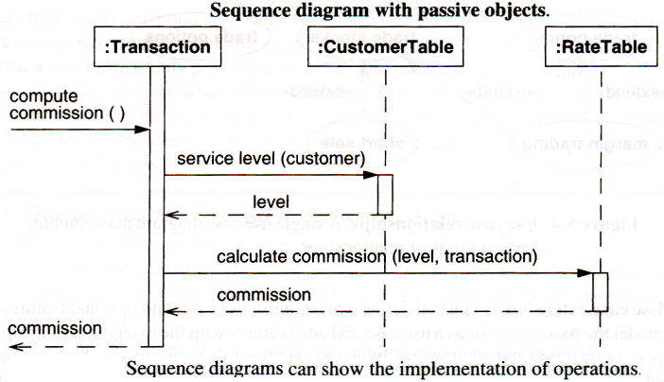
Figure below computes the commission for a stock brokerage transaction. The transaction object receives a request to compute its commission. It obtains the customer's service level from the customer table, then asks the rate table to compute the commission based on the service level, after which it returns the commission value to the caller.

Slide 93
The UML shows the period of time for an object's execution as a thin rectangle. This is called the activation or focus of control. An activation shows the time period during which a call of a method is being processed, including the time when the called method has invoked another operation. The period of time when an object exists but is not active is shown as a dashed line. The entire period during which the object exists is called the lifeline, as it shows the lifetime of the object.

Slide 94
Sequence Diagrams with Transient Objects
An object that exists only in memory and disappears when the application terminates execution is a transient object (in contrast to persistent object).

Slide 95
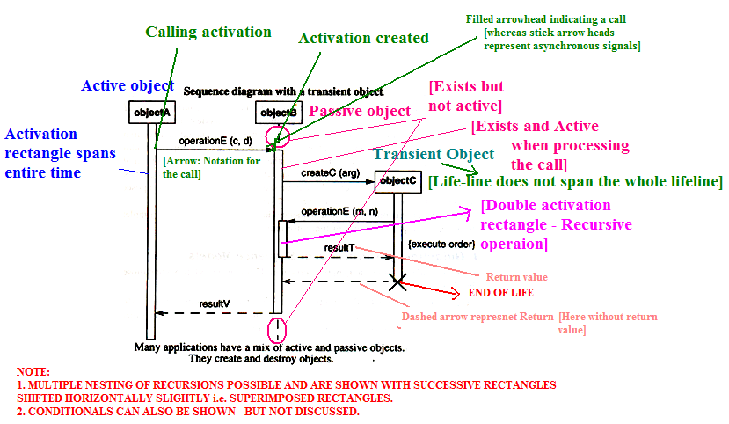

Slide 96
Special Constructs for Activity Models
Activity diagrams have additional notation that is useful for large and complex applications. They are:
Sending and Receiving Signals
Swimlanes
Object Flows

Slide 97
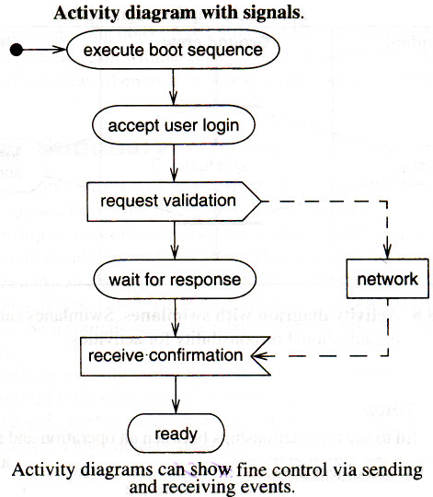
Sending and Receiving Signals
Workstation turned on:
sending of a signal as a convex pentagon
receiving of a signal as a concave pentagon

Slide 98
Swimlanes
In a business model, it is often useful to know which human organization is responsible for an activity. Sales, finance, marketing, and purchasing are examples of organizations. When the design of the system is complete, the activity will be assigned to a person, but at a high level it is sufficient to partition the activities among organizations.

Slide 99
Such a partitioning can be shown with an activity diagram by dividing it into columns and lines. Each column is called a swimlane by analogy to a swimming pool. Placing an activity within a particular swimlane indicates that it is performed by a person or persons within the organization. Lines across swimlane boundaries indicate interactions among different organizations, which must usually be treated with more care than interactions within an organization.
The horizontal arrangement of swimlanes has no inherent meaning, although there may be situations in which the order has meaning.

Slide 100
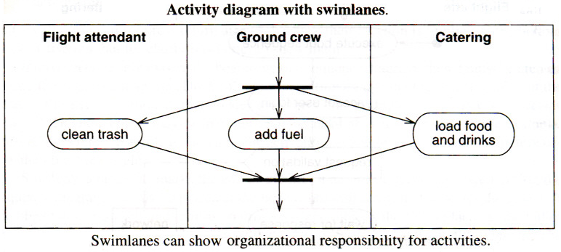
Figure shows a simple example for servicing an airplane. The flight attendants must clean the trash, the ground crew must add fuel, and catering must load food and drink before a plane is serviced and ready for its next flight.

Slide 101
Object Flows
Sometimes it is helpful to see the relationships between an operation and the objects that are its argument values or results.
An activity diagram can show objects that are inputs to or outputs from the activities. An input or output arrow implies a control flow, therefore it is unnecessary to draw a control flow arrow where there is an object flow.

Slide 102
Frequently the same object goes through several states during the execution of an activity diagram. The same object may be an input to or an output from several activities, but on closer examination an activity usually produces or uses an object in a particular state.
The UML shows an object value in a particular state by placing the state name in square brackets following the object name. If the objects have state names, the activity diagram shows both the flow of control and the progression of an object from state to state as activities act on it.

Slide 103
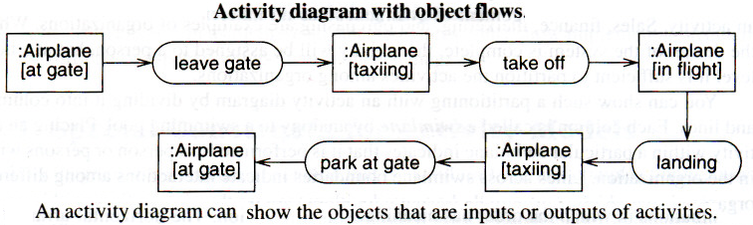
In Figure an airplane goes through several states as it leaves the gate, flies, and then lands again.

Slide 104
An activity diagram showing object flows among different object states has most of the advantages of a data flow diagram without most of their disadvantages. In particular, it unifies data flow and control flow, whereas data flow diagrams often separate them.

